Slide 1

Billionaire Wealth & Economic Trends
Key Insights & Takeaways
Notes:
This presentation explores the key factors driving billionaire wealth across industries, countries, and demographics. We’ll also examine economic correlations and trends shaping wealth distribution over time.

Slide 2
Billionaire Wealth & Economic Trends
Did you know that the combined wealth of the top 10 billionaires is greater than the GDP of over 100 countries?

Slide 3
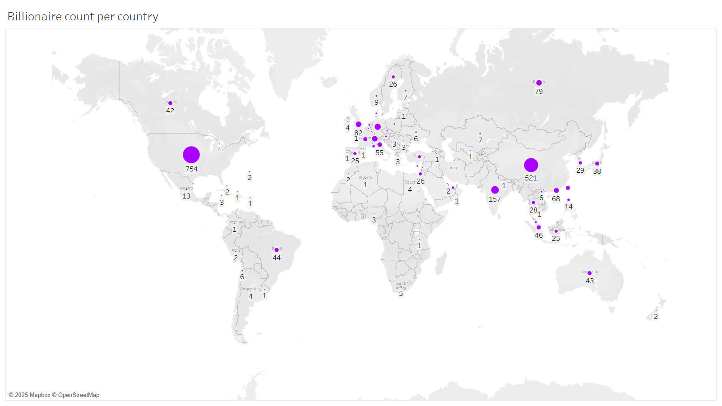
Wealth Distribution Country
Notes:
Billionaire wealth is not evenly distributed worldwide. The United States, China, and India dominate in billionaire count, reflecting their economic strength and innovation ecosystems.

Slide 4
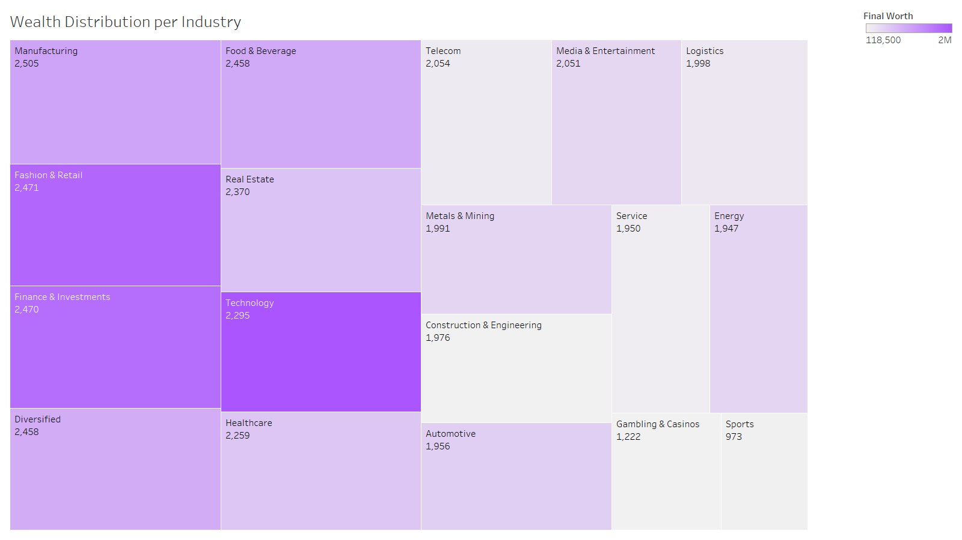
Wealth Distribution by Industry
Notes:
Tech and finance drive billionaire wealth, while traditional industries like retail and manufacturing still hold a significant share. However, innovation remains a key factor in long-term wealth accumulation.

Slide 5
Wealth Distribution by Industry & Country
Tech & Finance dominate billionaire wealth.
U.S., China, & India house the most billionaires.
Retail & traditional industries still hold major share, but innovation is key.
Notes:
Our analysis shows that technology and finance are the leading industries for billionaire wealth, followed by retail and manufacturing. Geographically, the United States, China, and India dominate the billionaire landscape, reinforcing their status as economic powerhouses. These trends highlight the importance of innovation and economic growth in wealth accumulation.

Slide 6
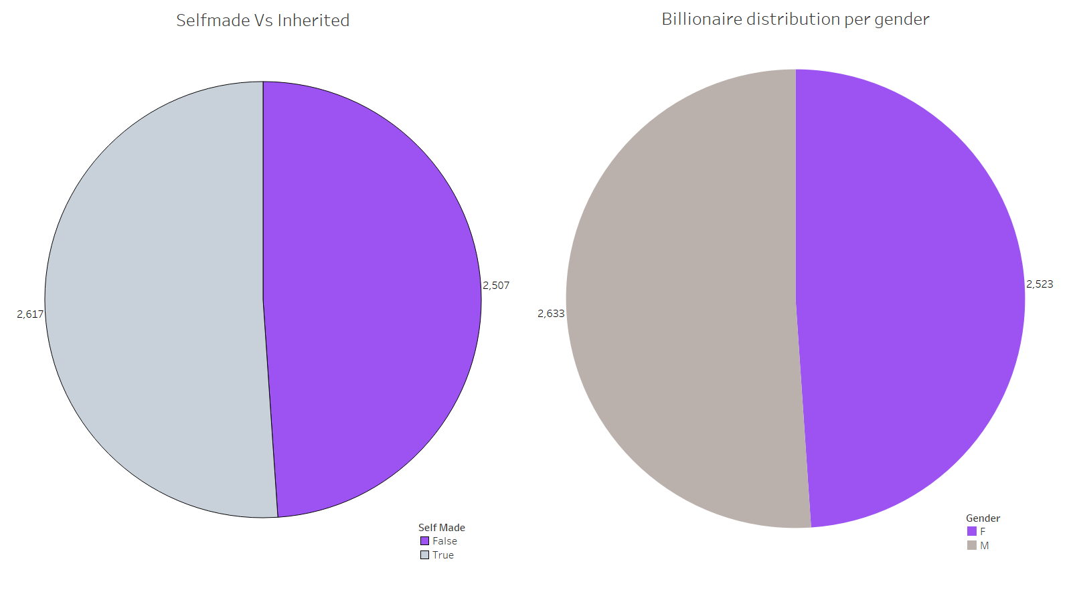
Demographics - Gender, & Self-Made vs. Inherited Wealth
Notes:
While billionaires are still predominantly male, the gap is closing. A significant number are self-made, showing that entrepreneurship is a key driver of wealth. However, inherited wealth remains strong in traditional industries.

Slide 7
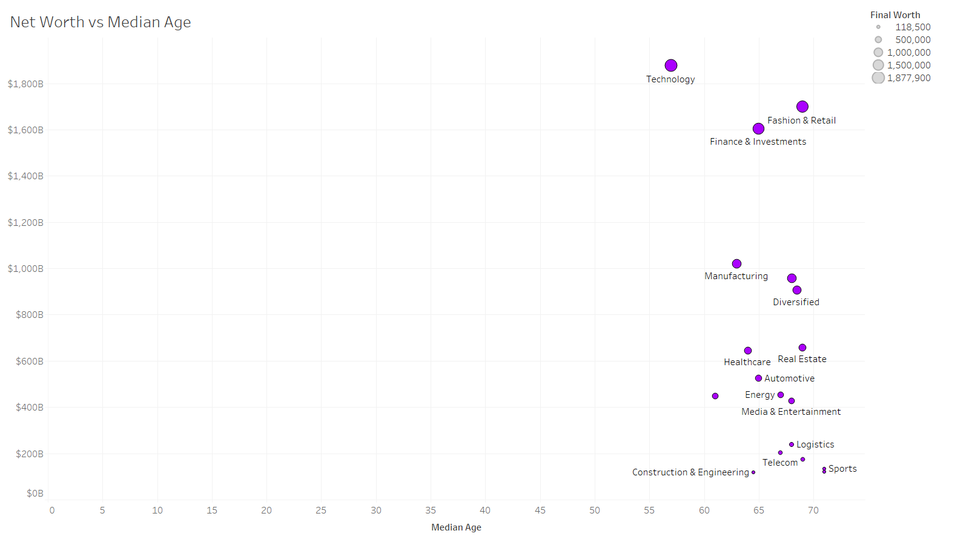
Demographics - Age
Notes:
When analyzing age and net worth, we see that billionaires in the tech industry tend to have higher net worths and a lower median age compared to those in other industries. Younger billionaires are predominantly in tech, while older billionaires have accumulated wealth in more traditional industries like finance and retail

Slide 8
Demographics - Age, Gender, & Self-Made vs. Inherited Wealth
Tech billionaires are younger, wealthier.
Traditional industries have older billionaires.
Finance, retail dominate older billionaire wealth.
Age and industry impact net worth.

Slide 9
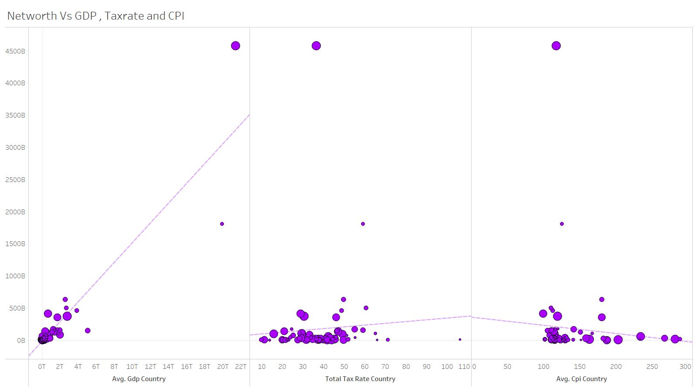
Economic Correlations – GDP, CPI, & Tax Rates
Notes:
Analysis reveals a strong correlation between GDP and billionaire wealth—countries with strong economies tend to produce more billionaires. Interestingly, while higher tax rates don’t necessarily prevent wealth accumulation, they do impact wealth mobility and investment behavior. Inflation and economic stability also play a role in preserving billionaire wealth over time.

Slide 10
Economic Correlations – GDP, CPI, & Tax Rates
Strong correlation between GDP growth & billionaire count.
Countries with higher GDPs tend to have more billionaires.
Tax rates show mixed impact—some high-tax countries still foster billionaire wealth.
Inflation & economic stability (CPI) affect long-term wealth retention.
Notes:
There is a strong correlation between GDP and billionaire wealth—richer economies produce more billionaires. However, the impact of tax rates is mixed; some high-tax countries still support billionaire growth. Inflation (CPI) plays a role in long-term wealth retention.

Slide 11
Trends Over Time & Future Outlook
Billionaire wealth is growing rapidly, particularly in emerging markets.
Tech & digital industries continue to create new billionaires.
Asia is gaining ground, with China & India showing increasing billionaire numbers.
Future wealth creation will be shaped by AI, sustainability, and fintech.
Notes:
Billionaire wealth is increasing, especially in emerging markets like China and India. The future of wealth creation will be driven by AI, sustainability, and fintech, reshaping the global economic landscape.

Slide 12
Final Takeaway
Innovation & disruption drive modern wealth.
Countries with strong economic growth foster billionaire expansion.
Future industries: AI, clean energy, and digital finance.
Policy & taxation will continue shaping global wealth distribution.
Notes:
To conclude, billionaire wealth is deeply tied to innovation, economic growth, and policy decisions. Tech and finance remain dominant, but AI, sustainability, and digital finance are the next frontiers. Understanding these trends helps businesses, policymakers, and investors prepare for the future of wealth creation.

Slide 13
THANK YOU
BY
NIVE VENKAT
Notes:
Thank you for your time. This analysis provides valuable insights into how wealth is created and distributed globally. I welcome any questions or discussions.

Slide 14
Data Set (Source)
https://www.kaggle.com/datasets/nelgiriyewithana/billionaires-statistics-dataset
Notes:
Geographically, the United States, China, and India dominate the billionaire landscape, reinforcing their status as economic powerhouses.

